Slide 1
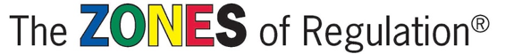
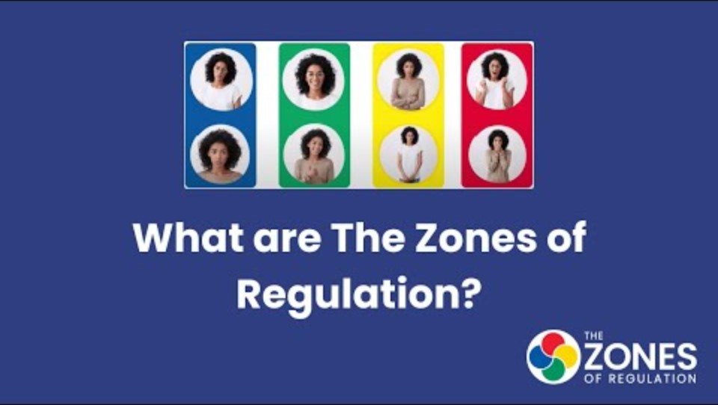
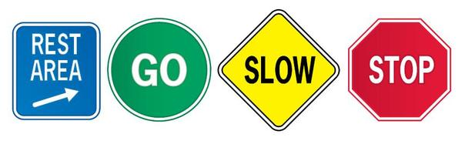

Slide 2
What are the zones?
The Zones of Regulation helps your child categorise how their body feels and explain their emotions. The four coloured zones help children to do this easily.
The Zones framework provides strategies to become more aware and independent in controlling emotions and impulses – the toolkit.
It also improves your child’s ability to problem solve conflicts and helps them to stay in the ‘expected’ zones in school.
A concept and tool used to help regulate feelings.

Slide 3
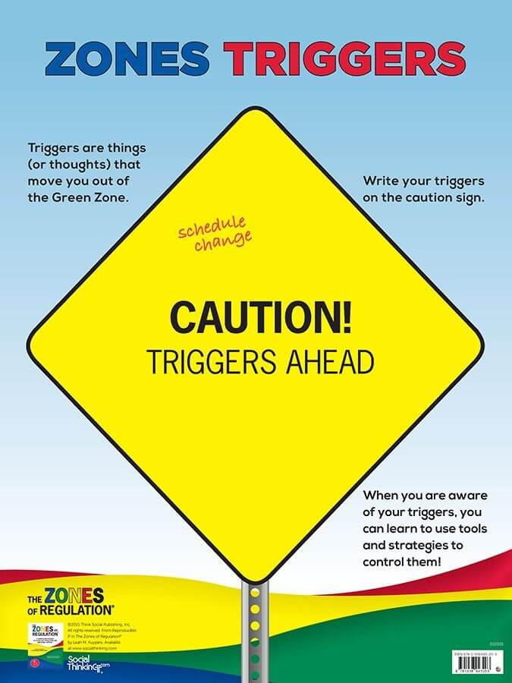
What triggers the zones?
An Emotional Trigger is a response to a person, situation, event, dialogue, reading, film etc, that provokes a strong emotional reaction in you.
Often you are not self aware when you are triggered and fall into reacting quickly, so the zones help you to think about any triggers that get a strong emotional response from you.

Slide 4
What is Regulation?
Self-regulation can go by many names, such as self-control, self-management and impulse control. It is defined as the best state of alertness of both the body and emotions for the specific situation.
For example, when children play on the playground, it is beneficial to have a higher state of alertness, however, that same state would not be appropriate in the classroom learning. So, it is important children become aware of the different zones and when it is appropriate to be in that zone – expected and unexpected behaviours.

Slide 5
How can we make the ZONES useful to us?
Use the language of colour to model and encourage talk about feelings and strategies to regulate them. For example, I might say if I can’t do something , “This is really stressing me out, I am feeling Yellow. I need to take some deep breaths and calm down.”
The more we hear about the ZONES, the more chance we will use them to help us self regulate our emotions!
Talk about the ZONES as they apply in a variety of environments and situations.
Talking about our emotions will help your child to see that it is natural to experience different zones.

Slide 6
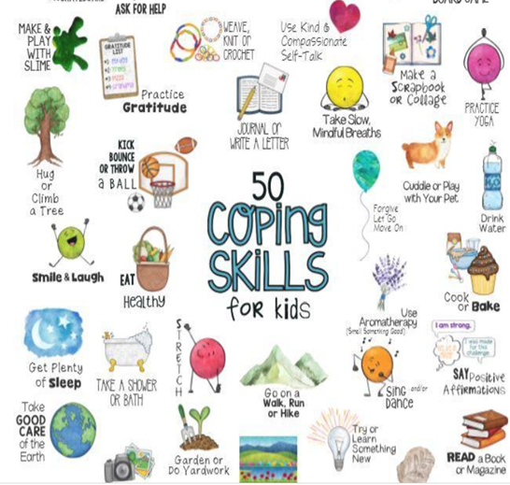
And remember….. there is no such thing as a bad ZONE!
It is important to note that everyone experiences all of the zones—the Red and Yellow Zones are not the “bad” or “naughty” zones.
We are teaching the children coping skills/strategies to get back into the Green zone and how to support others when they are feeling Yellow/Red.

Slide 7
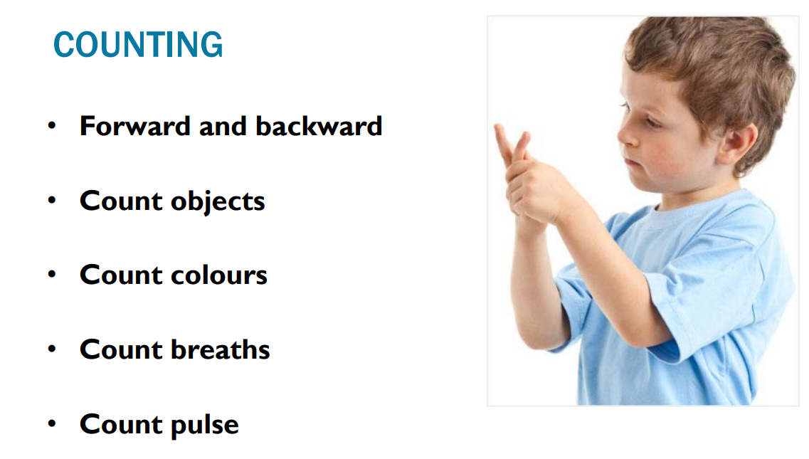
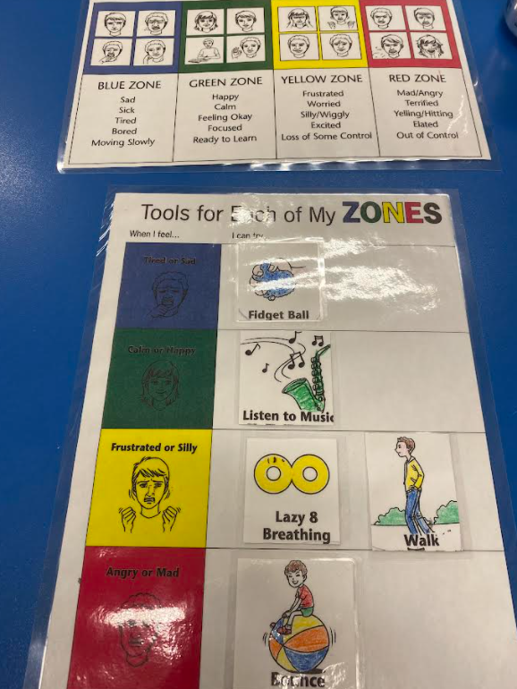
Classroom Self-Regulation Toolkit, Calm Corner and ZONES Visuals
Notes:
Visuals for Kids
*** Kindergarten student – Red Zone

Slide 8
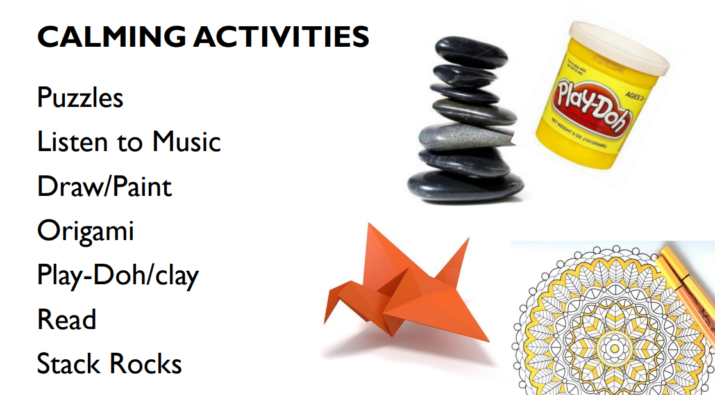

Slide 9



